Slide 1

NSW Health Audit Office of New South Wales
Data Platform Project Update
14 April 2026

Slide 3
Monthly Update
01
March – April 2026

Slide 4
Key Developments
9 March 2026: MoH Data Platform Project introduction (previous meeting)
16 March 2026: Initial Data Platform project briefing held with NSW Health project team
16 March 2026: Data matching clarification provided to eHealth
25 March 2026: Data Platform project timeline shared with NSW Health project team
2 April 2026: Technical discussion held with DAC and NSW Health on the Data Platform project, with a preliminary decision to ingest data from ADLS into Snowflake to reuse existing engineering and simplify NSW Health integration
13 April 2026: Confirmation provided to NSW Health on data transfer encryption and endpoint setup
16 April 2026: MoH Data Platform Project update (this meeting)
4

Slide 5
Project Timeline Overview
March 2026
Finalise foundational design and onboarding activities.
Confirm scope, sequencing and readiness for the main build phase.
Project tracking indicates this phase is on track and approaching a critical transition point.
April 2026
Complete remaining foundation work and close out early-stage dependencies.
Ramp up core build activities for delivery across the remainder of the year.
Final opportunity to stabilise the overall approach before downstream activities accelerate.
May 2026
Enter full report build phase for datasets.
Data ingestion, transformation and platform components progress in parallel.
Dependencies between workstreams become active and closely coordinated.
5

Slide 6
Project Timeline Overview (continued)
June 2026
Continue core build with increasing integration between components.
Early outputs emerge, supporting progressive validation.
July 2026 to February 2027 (expected project completion)
Transition from core build into stabilisation and rollout, with expanding platform capability across data domains and increasing focus on controls, validation and reliable end to end operation.
Through August and September, data flows are strengthened and the platform progresses toward operational readiness.
By October and November, implementation winds down and attention shifts to consolidation, optimisation and structured handover.
Core delivery is completed in December 2026, with the platform confirmed to be operating as intended.
January 2027 focuses on training, documentation and transition to business-as-usual operations, leading to formal project closure in February 2027 with the NSW Health data platform fully established and embedded.
6

Slide 7
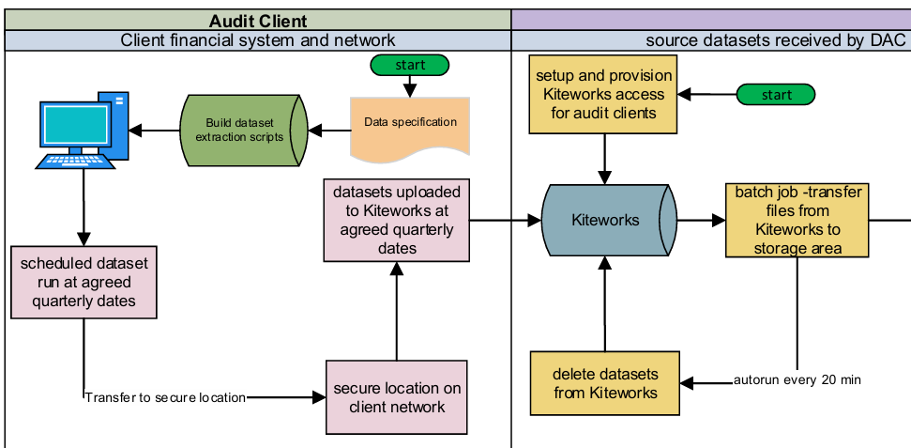
Data Pipeline (to be updated)
7

Slide 8
Key Risks and Forward Plan
Audit and IT General Controls (ITGC) Data extracted from business warehouses will be subject to ITGC review by systems assurance. Initial testing will use non‑production environments. Final ITGC scope will be determined with warehouse owners and relevant stakeholders. Timeline and Quarterly Extraction Target is quarterly extraction, typically from 15 days after quarter end, subject to ledger closure. Testing and development are planned this calendar year. Production go‑live is targeted for FY27, subject to dependencies including warehouse cloud migration. Manual processes will remain as a fallback if timelines shift
8

Slide 9
Related Business
02
March – April 2026

Slide 10
Related Business
Regular Data Download
Interim download due today (16 April 2026)
Other Data Requests
Premium labour data request
Internal controls and governance data request
10

Slide 11
Questions & Answers
03
Thank you for your time!

Slide 12
Upcoming Meetings
Already scheduled:
15 May 2026
16 June 2026
15 July 2026
18 August 2026
15 September 2026
15 October 2026
17 November 2026
16 December 2026
12

